Slide 1
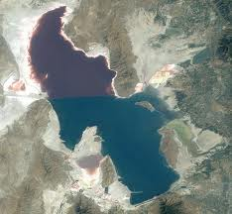
The Great Salt Lake

Slide 2
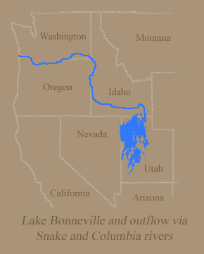
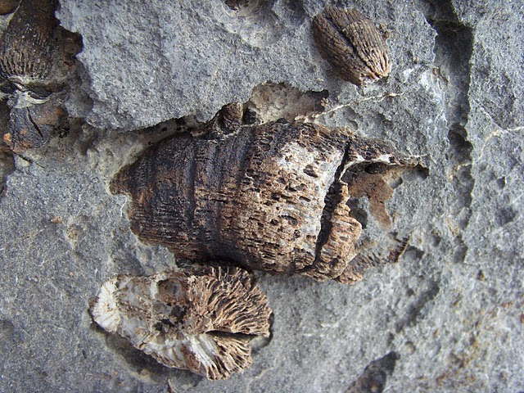
The GSL is a remnant of Lake Bonneville that formed 32,000 years ago and covered ¼ of Utah.
Fossils from this lake can be found in the mountain ranges surrounding the Salt Lake valley.

Slide 3
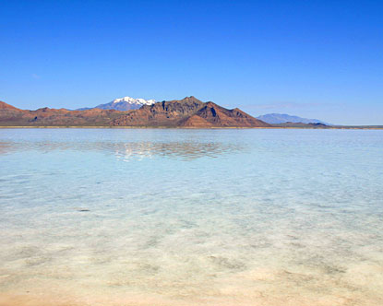
Profile:
The lake is 75 miles long and 28 miles wide.
It is a very shallow lake with a depth of only 33 feet.
It covers an area of about 1700 square miles.

Slide 4
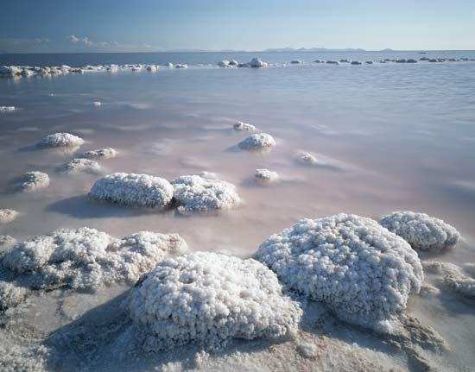
Salinity (amount of salt) ranges from 6% to 28 %
It is 3 to 5 times saltier than the ocean.

Slide 5
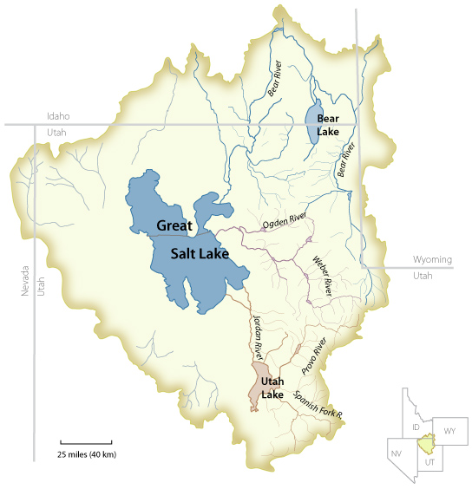
In and out of the lake:
Water enters through 3 rivers:
Bear River
Weber River
Jordan River
Water leaves by evaporation
only.
It is the largest lake west of the
Mississippi.

Slide 6
Salinity: salt concentration
The GSL is considered hypersaline (extra salty) and thus is a “simple” ecosystem because there are fewer species than in a fresh water lake.

Slide 7
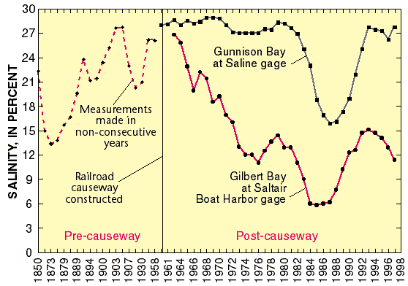

Slide 8
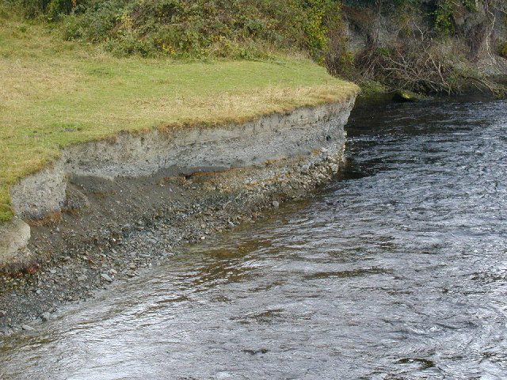
What is the source of the salt?
The salt comes from the rivers. As water flows it picks up salts from the soil. These are deposited in the Great Salt Lake. As water evaporates the salt remains behind.

Slide 9
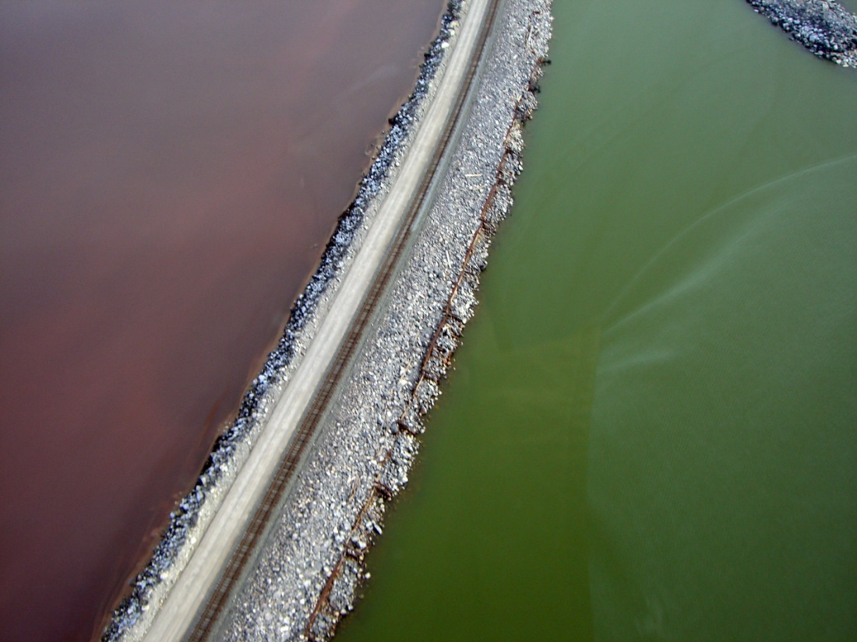
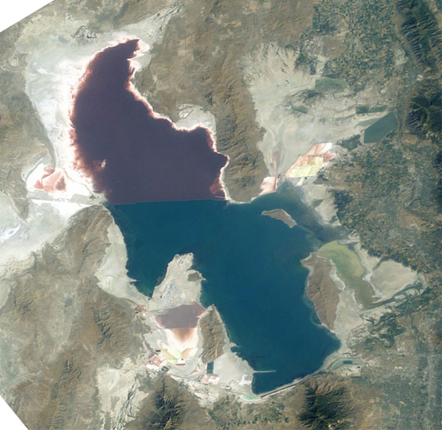
Effect of railway causeway:

Slide 10
The northern end of the lake has a higher salinity due to very little inflow. The salt concentrates as water evaporates.

Slide 11
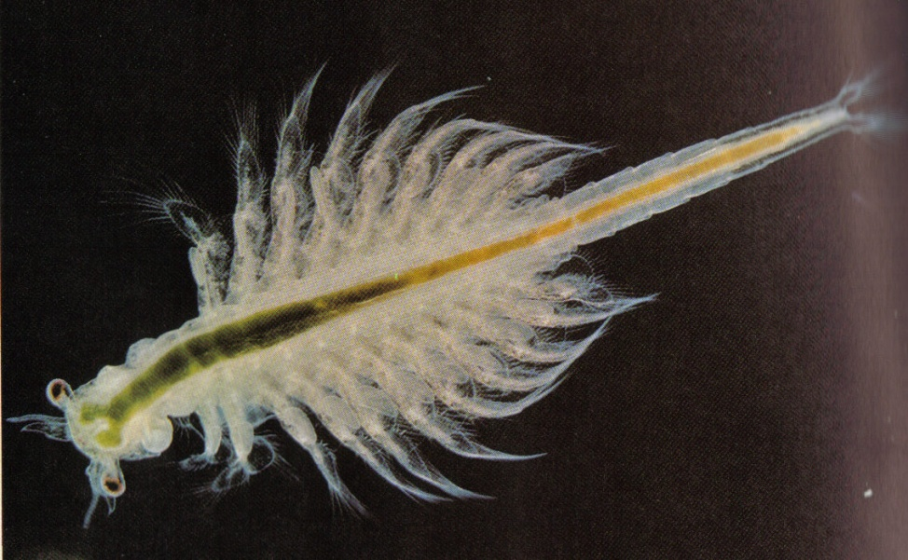
Animals
Brine shrimp-provide food for migratory birds. Their hard walled eggs are called cysts and are harvested for fish food.

Slide 12
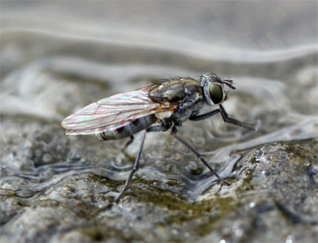
Brine flies-spend their larval stage on the bottom of the lake. They emerge as adults in early summer forming dense clouds.

Slide 13
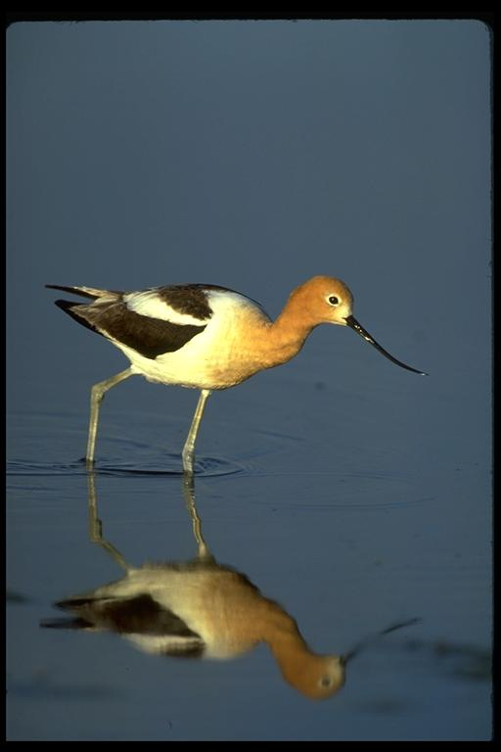
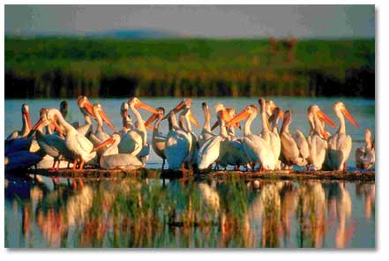
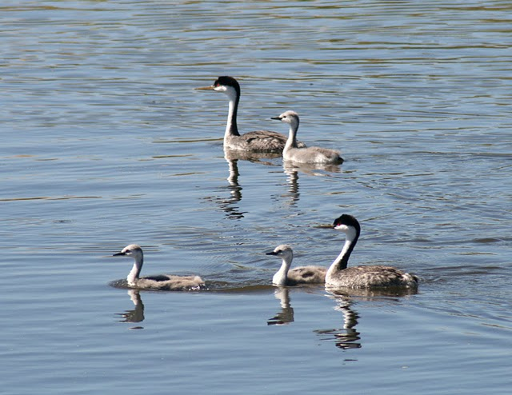
Shorebirds-the lake provides a resting and a nesting place for 2 to 5 million shorebirds and water fowl.

Slide 14
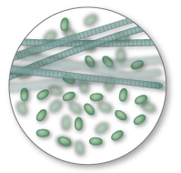
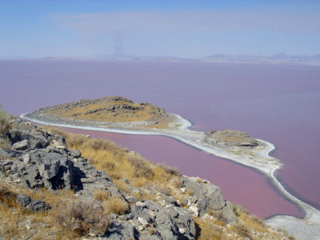
Bacteria-photosynthetic reddish bacteria color the water

Slide 15
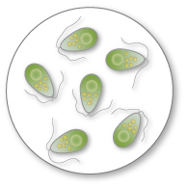
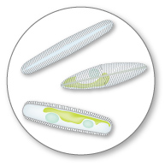
Algae-blooms occur in January when the water temperature is only a few degrees Celsius.

Slide 16
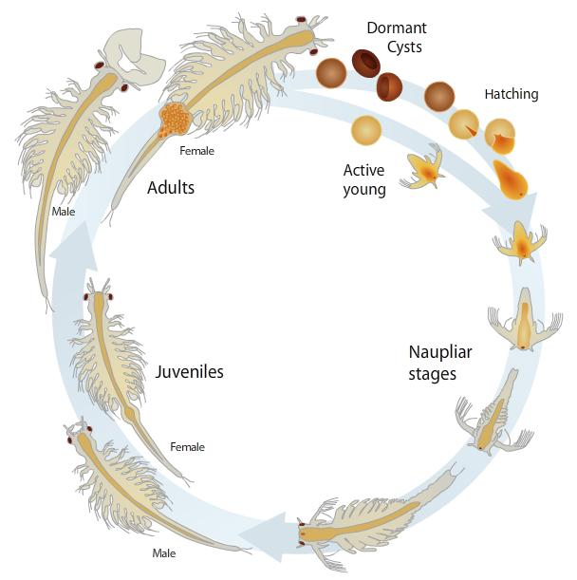
Brine shrimp life cycle
Hatching from cysts occurs in February and March.
Young feed on algae.
Young may molt 12 to 24 times.
Adults peak in late May.
The rate of development is affected by
salinity, temperature and food
availability.

Slide 17
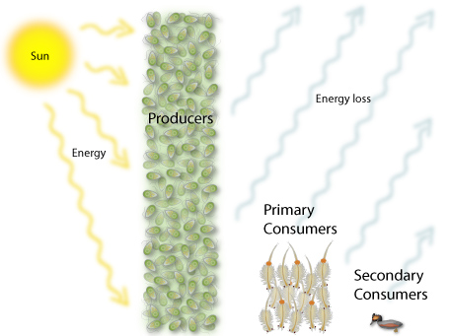
Great Salt Lake food web:

Slide 18
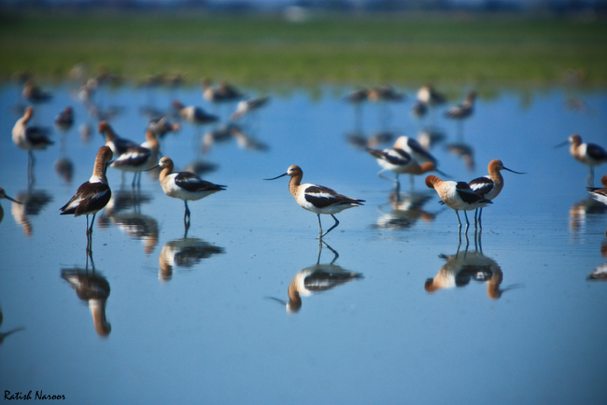
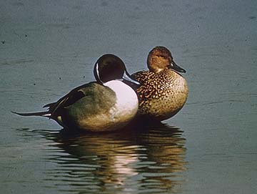
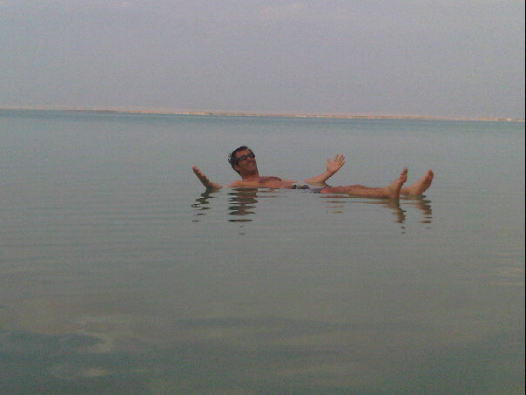
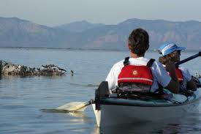
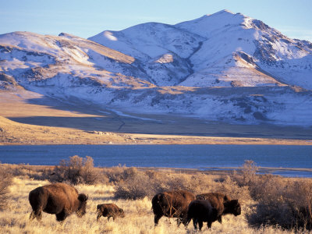
Tourism and Recreation
Birding
Hunting-ducks and geese
Swimming
Boating
Salt flats-racing
Island hiking, biking, horseback riding

Slide 19
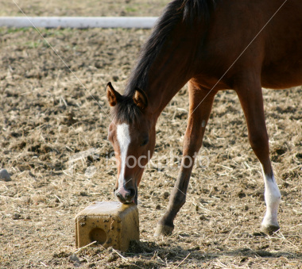
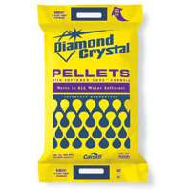
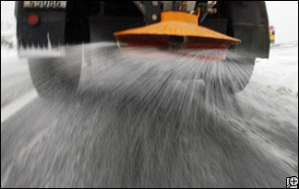
Commerce
Mining:
NaCl
Pellets for animal feed
Water softeners
Highway salt
Industrial uses

Slide 20
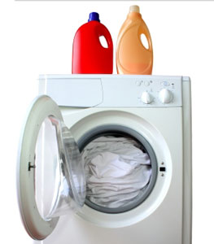
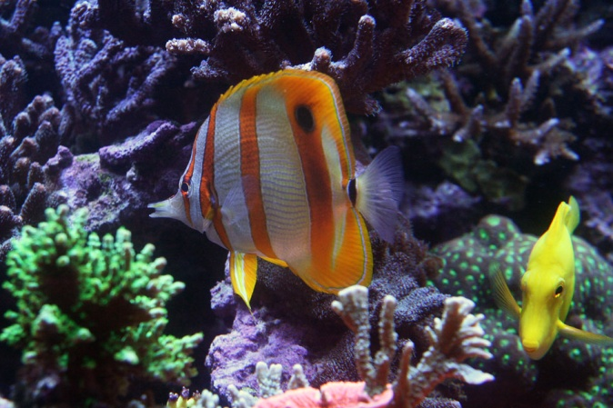
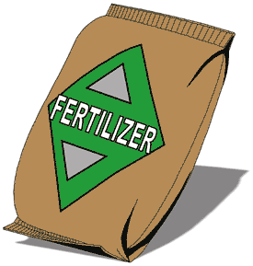
Sodium sulfate
Laundry soap
glass
Magnesium chloride
Sold to sea world to recreate sea water in exhibits
Potassium sulfate
fertilizer

Slide 21
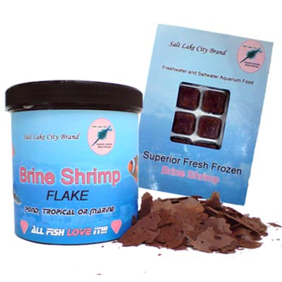
Harvesting
Harvesting began in 1950
Brine shrimp cysts are for fish food are collected and cleaned.

Slide 22
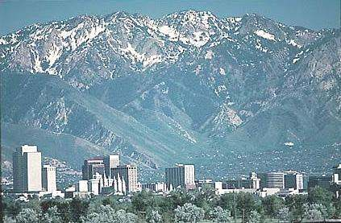
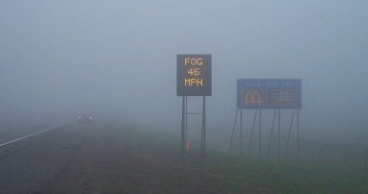
Weather
Lake effect
Occurs when there is colder air over warmer water (mainly in spring and fall)
Enhances snow and rain along the Wasatch front
Produces winds
Increases fog in valleys

